Slide 1

Modules and Objects
Import
Encapsulation
Object Fundamentals
Inheritance

Slide 2

See Also
https://docs.python.org/3/reference/import.html
https://python.swaroopch.com/oop.html
Notes:
Some additional information on concurrency

Slide 3
Import is a Verb
include.py
another.py
more.py
def sayHi():
print("Hello there from include")
print("Include running")
print("Include:"+__name__+":")
sayHi()
from another import sayHi
sayHi()
import more
more.sayHi()
def sayHi():
print("Hello there from another")
print("Another running")
print("Another:"+__name__+":")
def sayHi():
print("Hello there from more")
print("More running")
print("More:"+__name__+":")
More running
More:__main__:
Include running
Include:__main__:
Hello there from include
Another running
Another:another:
Hello there from another
More running
More:more:
Hello there from more
Notes:
You might be used to thinking of “imports” as “includes” that go at the top of the file like in other languages. They often do, but in python “import” is a verb. It does something only when it is executed.

Slide 4
Encapsulation
class NameKeeper(object):
def __init__(self):
self.name = "Chris Cantrell"
def get_name(self):
return("Chris Cantrell")
n = NameKeeper()
me = n.name
me = n.get_name()
print(me)
class NameKeeper(object):
def __init__(self):
self.first = "Chris"
self.last = "Cantrell"
def get_name(self):
return(self.first+" "+self.last)
n = NameKeeper()
me = n.name
me = n.get_name()
print(me)

Slide 5
Encapsulation
class NameKeeper(object):
def __init__(self):
self._name = "Chris Cantrell"
def get_name(self):
return("Chris Cantrell")
n = NameKeeper()
me = n._first
print(me)
Use “_” to indicate that things are private.
This is just a convention. It is not enforced at runtime.

Slide 6
Objects
class Point(object):
def __init__(self, x, y):
self._x = x
self._y = y
def get_x(self):
return self._x
def get_y(self):
return self._y
def __repr__(self):
return "("+str(self._x)+","+str(self._y)+")"
#return "("+str(self.get_x())+","+str(self.get_y())+")"

Slide 7
Objects
class RandomPoint(Point):
def __init__(self):
super().__init__(0,0)
def get_x(self):
return random.randint(0,10)
def get_y(self):
return random.randint(0,10)
class Line(object):
def __init__(self, a, b):
self._a = a
self._b = b
def get_a(self):
return self._a
def get_b(self):
return self._b
def get_length(self):
dx = self._a._x - self._b._x
dy = self._a._y - self._b._y
#dx = self._a.get_x() - self._b.get_x()
#dy = self._a.get_y() - self._b.get_y()
return sqrt(dx*dx +dy*dy)

Slide 8
Objects
class RandomPoint(Point):
def __init__(self):
super().__init__(0,0)
def get_x(self):
return random.randint(0,10)
def get_y(self):
return random.randint(0,10)
class Line(object):
def __init__(self, a, b):
self._a = a
self._b = b
def get_a(self):
return self._a
def get_b(self):
return self._b
def get_length(self):
dx = self._a._x - self._b._x
dy = self._a._y - self._b._y
#dx = self._a.get_x() - self._b.get_x()
#dy = self._a.get_y() - self._b.get_y()
return sqrt(dx*dx +dy*dy)
a = Point(2,1)
b = Point(6,4)
r = RandomPoint()
line = Line(r,r)
print(line.get_length())
print(r)

Slide 9
Inheritance
class Animal(object):
def __init__(self, num_legs):
self._num_legs = num_legs
def sayHi(self):
return "????"
def get_num_legs(self):
return self._num_legs
class Dog(Animal):
def __init__(self):
Animal.__init__(self,4)
def sayHi(self):
return "Bark"
class Human(Animal):
def __init__(self):
Animal.__init__(self,2)
def sayHi(self):
return "Hello"
animal = Dog()
print(animal.sayHi())
print("I have "+str(animal.get_num_legs())+" legs")

Slide 10
Design Patterns
Reference the gang of four patterns
Decorator … composition vs inheritance, French, Canadian
class Canadian(Animal):
def __init__(self,other):
self._other = other
def sayHi(self):
return self._other.sayHi()+" eh"
def get_num_legs(self):
return self._other.get_num_legs()
class French(Animal):
def __init__(self,other):
self._other = other
def sayHi(self):
return "Le "+self._other.sayHi()
def get_num_legs(self):
return self._other.get_num_legs()
animal = French(Canadian(French(Dog())))
print(animal.sayHi())
print("I have "+str(animal.get_num_legs())+" legs")

Slide 11
Diamond of Death
class Werewolf(Dog, Human):
def __init__(self):
Dog.__init__(self)
Human.__init__(self)
def sayHi(self):
return Human.sayHi(self)+" "+Dog.sayHi(self)
#animal = French(Canadian(French(Dog())))
animal = Werewolf()
print(animal.sayHi())
print("I have "+str(animal.get_num_legs())+" legs")
Hello Bark
I have 2 legs

Slide 12
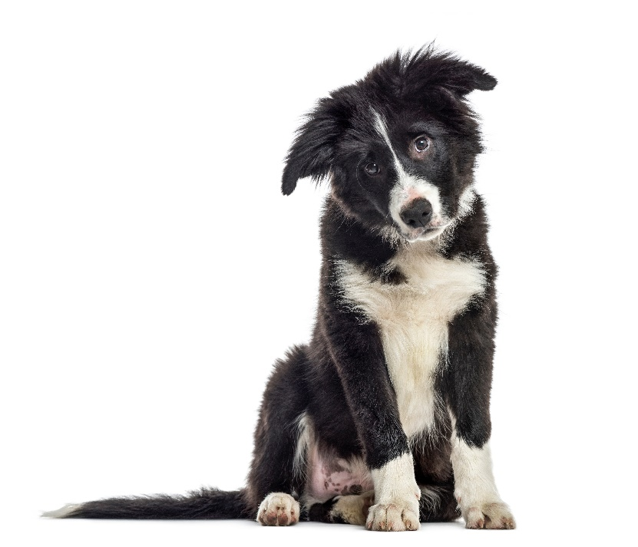
Tinkering
Type in the Animals example.
Create a Centaur class (half man, half horse).
Create a SHOUT decorator that converts all “sayHi” to all upper case.
Notes:
Here are some things to think about … nothing to submit.
Share your thoughts in the online portal discussion area.

